Slide 1



Chapter 2:
Digital Image Fundamentals
Lecturer: Wanasanan Thongsongkrit Email : wanasana@eng.cmu.ac.th
Office room : 410
Human and Computer Vision
We can’t think of image processing without considering the human vision system. We observe and evaluate the images that we process with our visual system.
Without taking this elementary fact into consideration, we may be much misled in the interpretation of images.
2

Slide 2
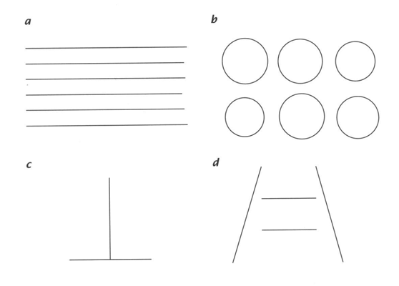
Simple questions
What intensity differences can we distinguish?
What is the spatial resolution of our eye?
How accurately we estimate and compare distances and areas?
How do we sense colors?
By which features can we detect and distinguish objects?
3
Test images
4

Slide 3
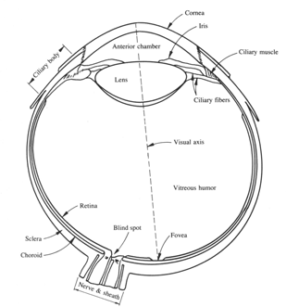
Test images
Test images for distances and area estimation:
Parallel lines with up to 5% difference in length.
Circles with up to 10% difference in radius.
The vertical line appears longer but actually has the same length as the horizontal line.
Deception by perspective: the upper line appears longer than the lower one but actually have the same length.
5
Structure of the Human Eye
Shape is nearly a sphere.
Average diameter = 20 mm.
3 membranes:
Cornea and Sclera - outer cover
Choroid
Retina -enclose the eye
6

Slide 4
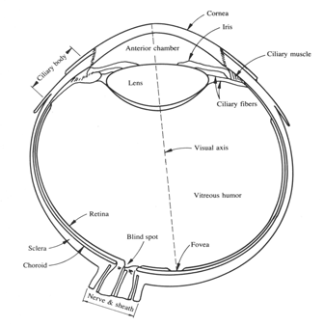
Structure of the Human Eye
Cornea :
tough, transparent tissue, covers the anterior surface of the eye.
Sclera :
Opaque membrane, encloses the remainder of the optic globe
7
Structure of the Human Eye
Choroid :
Lies below the sclera, contains network of blood vessels that serve as the major source of nutrition to the eye.
Choroid coat is heavily pigmented and hence helps to reduce the amount of extraneous light entering the eye and the backscatter within the optical globe.
8

Slide 5
Lens & Retina
Lens
both infrared and ultraviolet light are absorbed appreciably by proteins within the lens structure and, in excessive amounts, can cause damage to the eye.
Retina
Innermost membrane of the eye which lines inside of the wall’s entire posterior portion. When the eye is properly focused, light from an object outside the eye is imaged on the retina.
9
Receptors
Pattern vision is afforded by the distribution of discrete light receptors over the surface of the retina.
Receptors are divided into 2 classes:
Cones
Rods
10

Slide 6
Cones
6-7 million, located primarily in the central portion of the retina (the fovea, muscles controlling the eye rotate the eyeball until the image falls on the fovea).
Highly sensitive to color.
Each is connected to its own nerve end thus human can resolve fine details.
Cone vision is called photopic or bright-light vision.
11
Rods
75-150 million, distributed over the retina surface.
Several rods are connected to a single nerve end reduce the amount of detail discernible.
Serve to give a general, overall picture of the field of view.
Sensitive to low levels of illumination.
Rod vision is called scotopic or dim-light vision.
12

Slide 7
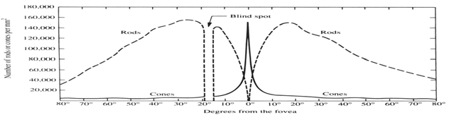
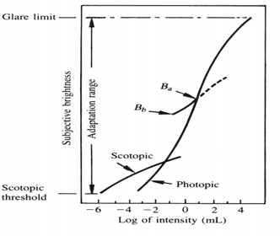
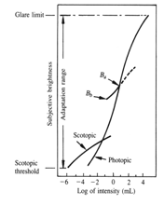
Cross section of the right eye
Blind spot c:: the absence of receptors area.
Receptor density is measured in degrees from the fovea.
Cones are most dense in the center of the retina (in the area of the fovea).
Rods increase in density from the center out to approx. 20° off axis and then decrease in density out to the
extreme periphery of the retina.
13
Brightness adaptation and discrimination
The total range of intensity levels it can discriminate simultaneously is rather small compared with the total adaptation range.
B_{a} is a brightness adaptation level. The short intersecting curve represents the range of subjective brightness that the eye can perceive when adapted to this level.
14

Slide 8
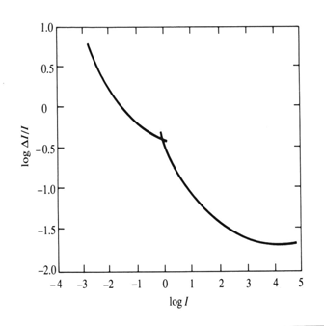

Contrast sensitivity
I+ΔI_{c}
The ability of the eye to discrimination b/w changes in brightness at any specific adaptation level is of considerable interest.
I is uniformly illumination on a flat area large enough to occupy the entire field of view.
I
Weber's ratio: ΔI /I
c
Good brightness discrimination
¢ ΔI_{c}I
Bad brightness discrimination
ΔI_{c} is the change in the
object brightness required to just distinguish the object from the background
15
¢ ΔI_{c}/I is large.
Weber ratio
Good
■
■
brightness discrimination is poor (the Weber ratio is large) at low levels of illumination and improves significantly (the ratio decreases) as background illumination increases.
hard to distinguish the discrimination when it is bright area but easier when the discrimination is on a dark area.
rods
discrimination
cones
Poor
Low
High
log
level illumination
16

Slide 9
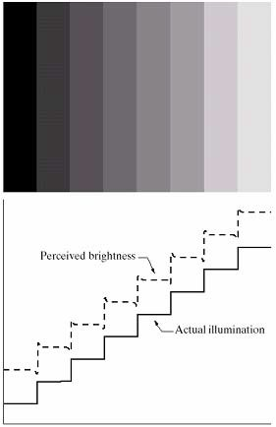
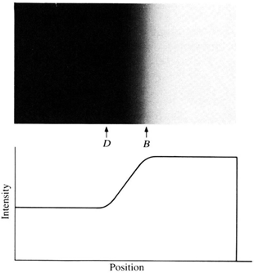
Brightness vs.Function of intensity
Brightness is not a simple function of intensity.
visual system tends to undershoot or overshoot around the boundary of regions of different intensities.
the intensity of the stripes is constant but we actually perceive a brightness pattern is strongly scalloped near
the boundaries.
17
Mach band pattern
Is it the same level of darkness around area D and B ?
The brightness pattern perceived is a darker
stripe in region D and a
brighter one in the region B whereas actually the region from D to B has the same intensity.
Note: it was named for Ernst Mach who discovered the phenomenon in 1865.
18

Slide 10
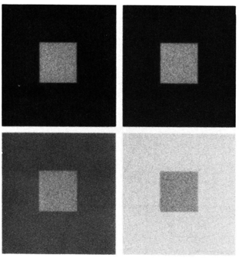
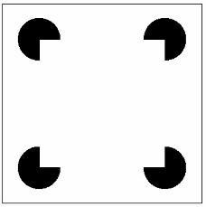
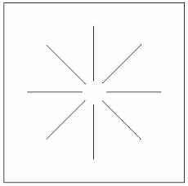
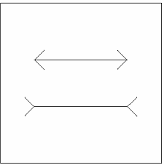
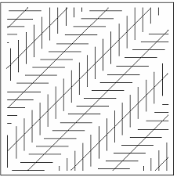
Simultaneous contrast
Which small square is the darkest one ?
All the small squares have exactly the same intensity, but they appear to the eye progressively darker as the background becomes brighter.
Region’s perceived brightness does not depend simply on its intensity.
19
Human Perception Phenomena
20

Slide 11
Signals
a signal is a function that carries information.
usually content of the signal changes over some set of spatiotemporal dimensions. Vocabulary:
h^{sp}avªi^{t}n^{io}g^{te}b^{m}ot^{p}hºs^{r}pªa^{l}ti:a^{e}l ^{x}e^{i}x^{s}te^{in}n^{g}si^{i}o^{n}n^{b}aºn^{t}d^{h} t^{s}e^{p}m^{ac}p^{e}orªa^{n}l^{d}d^{t}u^{im}ra^{e}ti;on
21
Time-Varying Signals
Some signals vary over time:
f(t)
for example: audio signal
may be thought at one level as a collection various tones of differing audible frequencies that vary over time.
22

Slide 12
Spatially-Varying Signals
Signals can vary over space as well.
An image can be thought of as being a function of 2 spatial dimensions:
f(x,y)
for monochromatic images, the value of the function is the amount of light at that point.
medical CAT and MRI scanners produce images that are functions of 3 spatial dimensions:
f(x,y,z)
23
Spatiotemporal Signals
What do you think a signal of this form is?
f(x,y,t)
x and y are spatial dimensions;
t is time.
o^{P}r^{er}o^{h}tªh^{p}e^{s}r,tim^{t i}e^{s}-ªva^{v}r^{i}y^{d}i^{e}nºg^{s}p^{ig}ic^{n}tªu^{l}r,eªs^{n}e^{i}q^{m}uªe^{t}n^{io}c^{n}e,.
24

Slide 13
Types of Signals
most naturally-occurring signals are functions having a continuous domain.
however, signals in a computer have are discrete samples of the continuous domain.
in other words, signals manipulated by computer have discrete domains.
25
Analog & Digital
most naturally-occurring signals also have a real-valued range in which values occur with infinite precision.
to store and manipulate signals by computer we need to store these numbers with finite precision. thus, these signals have a discrete range.
signal has continuous domain and range = analog
signal has discrete domain and range = digital
26

Slide 14
Sampling
sampling = the spacing of discrete values in the domain of a signal.
sampling-rate = how many samples are taken per unit of each dimension. e.g., samples per second, frames per second,
etc.
f(t)
t
27
Quantization
Quantization = spacing of discrete values in the range of a signal.
usually thought of as the number of bits per sample of the signal. e.g., 1 bit per pixel (b/w images), 16-bit audio, 24-bit color images, etc.
f(t)
7
8 levels = 2³ : uses 3 ^{b}v^{i}a^{t}l^{s}u^{t}eºo^{r}f^{ep}th^{r}e^{s}f^{e}u^{n}n^{t}c^{t}t^{h}io^{e}n.
0
t
28

Slide 15
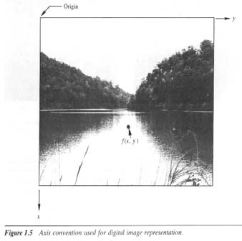
Digital Image Representation
y
A digital image is an image f(x,y) that has been digitized both in spatial coordinates and brightness.
f(x,y)
the value of f at any point (x,y) is proportional to the brightness (or gray level) of the image at that point.
x
29
Digital Image Representation
A digital image can be considered a matrix whose row and column indices identify a point in the image and the corresponding matrix element value identifies the gray level at that point.
30

Slide 16
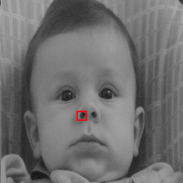
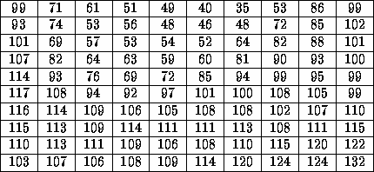
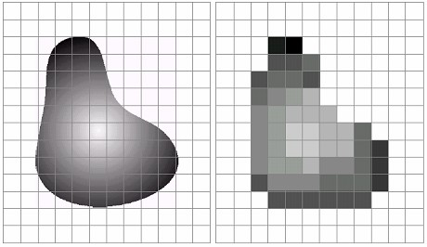
Digital Image Representation
Pixel values in highlighted region
CAMERA
DIGITIZER
A set of number in 2D grid
Samples the analog data and digitizes it.
31
Example of Digital Image
Continuous image
Result of image
projected onto a
sampling and
sensor array
quantization
32

Slide 17
Light-intensity function
image refers to a 2D light-intensity function, f(x,y)
the amplitude of f at spatial coordinates (x,y) gives the intensity (brightness) of the image at that point.
light is a form of energy thus f(x,y) must be nonzero and finite.
0 < f ( x, y) < ∞
33
Illumination and Reflectance
the basic nature of f(x,y) may be characterized by 2 components:
the amount of source light incident on the
scene being viewed ¢ Illumination, i(x,y)
the amount of light reflected by the
objects in the scene ¢ Reflectance, r(x,y)
34

Slide 18
Illumination and Reflectance
f (x, y) = i(x, y)r(x, y)
0 < i(x, y) < ∞
determined by the nature of the light source
0 < r(x, y) < 1
determined by the nature of the objects in _{t}a_{o}s_{t}c_{a}e_{l} n_{r}e_{ef}c:_{lec}b_{t}o_{a}u_{n}n_{c}d_{e}e.d from total absorption to
35
Gray level
we call the intensity of a monochrome image f at coordinate (x,y) the gray level (l) of the image at that point.
thus, l lies in the range L_{min} ≤ l ≤ L_{max}
L_{min} is positive and L_{max} is finite.
gray scale = [L_{min}, L_{max}]
common practice, shift the interval to [0, L]
0 = black , L = white
36

Slide 19
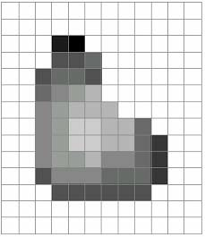
Number of bits
The number of gray levels typically is an integer power of 2
L = 2^{k}
Number of bits required to store a digitized image
b = M x N x k
N
M
37
Resolution
Resolution (how much you can see the detail of the image) depends on sampling and gray levels.
the bigger the sampling rate (n) and the gray scale (g), the better the approximation of the digitized image from the original.
the more the quantization scale becomes, the bigger the size of the digitized image.
38

Slide 20
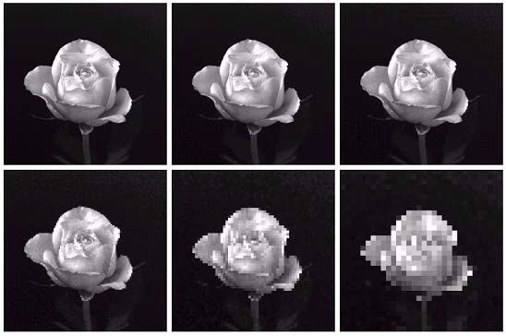
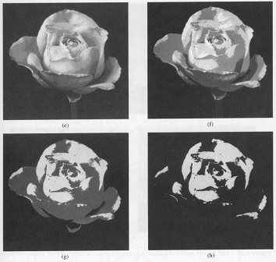
Checkerboard effect
a | b | c
d | e | f
1024x1024
512x512
256x256
128x128
64x64
32x32
if the resolution is decreased too much, the checkerboard
effect can occur.
39
False contouring
Gray level = 16
Gray level = 8
Gray level = 4
Gray level = 2
if the gray scale is not enough, the smooth area
(a)
(b)
will be affected.
False contouring can occur on the smooth area which has fine gray scales.
(c)
(d)
40

Slide 21
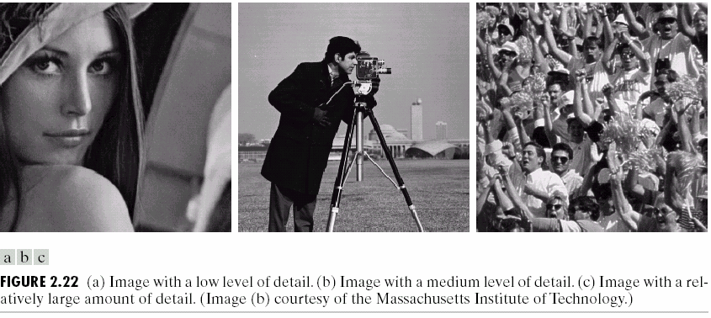
Nonuniform sampling
for a fixed value of spatial resolution, the appearance of the image can be improved by using adaptive sampling rates.
fine sampling c> required in the neighborhood of sharp gray-level transitions.
coarse sampling c> utilized in relatively smooth regions.
41
Example
42

Slide 22
Example
an image with a face superimposed on a uniform background.
background ¢ little detailed information
¢ coarse sampling is enough.
face ¢ more detail ¢ fine sampling.
if we can use adaptive sampling, the quality of the image is improved.
Moreover, we should care more around the boundary of the object ¢ sharp gray-level transmission from object to background.
43
Nonuniform quantization
unequally spaced levels in quantization process influences on the decreasing the number of gray level.
use few gray levels in the neighborhood of boundaries. Why ? eye is relatively poor at estimate shades of gray near abrupt level changes.
use more gray levels on smooth area in order to avoid the “false contouring”.
44

Slide 23
Basic Relationship b/w pixels
Neighbors of a pixel
Connectivity
Labeling of Connected Components
Relations, Equivalences, and Transitive Closure
Distance Measures
Arithmetic/Logic Operations
45
Neighbors of a pixel
a pixel p at coordinate (x,y) has
N₄(p) : 4-neighbors of p
(x+1, y), (x-1,y),(x,y+1), (x,y-1)
x
x p x x
N_{D}(p) : 4-diagonal neighbors of p (x+1, y+1), (x+1,y-1),(x-1,y+1), (x-1,y-1)
x
x
p
x
x
N₈(p) : 8-neighbors of p :
a combination of N₄(p) and N_{D}(p)
x x x
x p x
x x x
46

Slide 24
Connectivity
Let V be the set of gray-level values used to defined connectivity
4-connectivity :
2 pixels p and q with values from V are 4-connected if q is in the set N₄(p)
8-connectivity :
2 pixels p and q with values from V are 8-connected if q is in the set N₈(p)
m-connectivity (mixed connectivity):
2 pixels p and q with values from V are m-connected if
q is in the set N₄(p) or
q is in the set N_{D}(p) and the set N₄(p)∩N₄(q) is empty.
(the set of pixels that are 4-neighbors of both p and q whose values are from V ) 47
Example
0 1 1
0 1 0
0 0 1
0 1 1
0 1 0
0 0 1
0 1 1
0 1 0
0 0 1
ar_{o}ra_{f}n_{p}g_{i}e_{x}m_{el}e_{s}nt
t⁸h⁻e^{n}c^{e}e^{ig}n^{h}te^{b}rºp^{rs}ixºe^{f}l
t^{m}he^{-n}c^{e}e^{ig}n^{h}te^{b}rºp^{r}i^{s}xºe^{f}l
m-connectivity eliminates the multiple path connections that arise in 8-connectivity.
48

Slide 25
Adjacent
a pixel p is adjacent to a pixel q if they are connected.
two image area subsets S1 and S2 are adjacent if some pixel in S1 is adjacent to some pixel S2.
49
Path
a path from pixel p with coordinates (x,y) to pixel q with coordinates (s,t) is a sequence of distinct pixels with coordinates
(x₀,y₀),(x₁,y₁),…(x_{n},y_{n})
where (x₀,y₀) = (x,y) , (x_{n},y_{n}) = (s,t) and (x_{i},y_{i}) is adjacent to (x_{i-1},y_{i-1})
n is the length of the path
we can define 4-,8-, or m-paths depending on type of adjacency specified.
50

Slide 26
Exercise
Consider the tw_{S}o image su_{S}bsets S₁ and S₂ :
1
2
0
1
1
0
0 | 0 | 0 | 0 | 0 | 0 | 1 | 1
0 | 0 | 1 | 0 | 0 | 1 | 0 | 0
0 | 0 | 1 | 0 | 1 | 1 | 0 | 0
0 | 1 | 1 | 1 | 0 | 0 | 0 | 0
0
1
0
0
0 0 1 1 1 0 0 1 1 1
For V={1}, determine whether S₁ and S₂ are
4-connected
8-connected
m-connected
51
Labeling of Connected Components
scan the image from left to right
Let p denote the pixel at any step in the scanning process.
Let r denote the upper neighbor of p.
Let t denote the left-hand neighbors of p, respectively.
when we get to p, points r and t have already been encountered and labeled if
they were 1’s.
r
t p
52

Slide 27
Labeling of Connected Components
if the value of p = 0, move on.
if the value of p = 1, examine r and t.
if they are both 0, assign a new label to p.
if only one of them is 1, assign its label to p.
if they are both 1
if they have the same label, assign that label to p.
if not, assign one of the labels to p and make a note that the two labels are equivalent. (r and t are connected through p).
at the end of the scan, all points with value 1 have been labeled.
do a second scan, assign a new label for each
equivalent labels.
53
What shall we do with
8-connected components ?
do the same way but examine also the upper diagonal neighbors of p.
if p is 0, move on.
if p is 1
if all four neighbors are 0, assign a new label to p.
if only one of the neighbors is 1, assign its label to p.
if two or more neighbors are 1, assign one of the label to p and make a note of equivalent classes.
after complete the scan, do the second round and introduce a unique label to each equivalent class.
54

Slide 28
Distance Measures
for pixel p, q and z with coordinates (x,y), (s,t) and (u,v) respectively,
D is a distance function or metric if
(a) D(p,q) ≥ 0 ; D(p,q) = 0 iff D=q
(b) D(p,q) = D(q,p)
(c) D(p,z) ≤ D(p,q) + D(q,z)
55
Euclidean distance between p and q
D ( p, q) = [(x − s) + ( y − t) ]
1
2 2
2
e
q(s,t)
r
t-y
p(x,y)
s-x
radius (r) centered at (x,y)
56

Slide 29
City-block distance: D₄ distance
 | 2
2 | 1 | 2
2 1 | 0 | 1 | 2
2 | 1 | 2
 | 2
D₄ ( p, q) = x − s + y − t
diamond centered at (x,y)
D₄ =1 are 4-neighbors of (x,y)
57
Chessboard distance: D₈ distance
D₈ ( p, q) = max( x − s + y − t )
2 | 2 | 2 | 2 | 2
2 | 1 | 1 | 1 | 2
2 | 1 | 0 | 1 | 2
2 | 1 | 1 | 1 | 2
2 | 2 | 2 | 2 | 2
square centered at (x,y)
58

Slide 30
D₄ and D₈ distances
D₄ distance and D₈ distance between pixel p and q = length 4- and 8-path between those 2 points, respectively.
we can consider both D₄ and D₈ distances b/w p and q regardless of whether a connected path exists between them because the definitions of these distances involve only the coordinates.
59
m-connectivity’s distance
distances of m-connectivity of the path between 2 pixels depends on values of pixels along the path.
e.g., if only connectivity of pixels valued 1 is allowed. find the m-distance b/w p and p₄
p₃ p₄ 0 1 1 1 1 1
p₁ | p₂ | 0 | 1 | 0 | 1 | 1 | 1
p |  | 1 |  | 1 |  | 1
distance = 2
distance = 3
distance = 4
60

Slide 31
Arithmetic Operators
used extensively in most branches of image processing.
Arithmetic operations b/w 2 pixels p and q :
Addition : p+q used in image average to reduce noise.
Subtraction : p-q basic tool in medical imaging.
Multiplication : pxq
to correct gray-level shading result from nonuniformities in illumination or in the sensor used to acquire the image.
Division : p÷q
Arithmetic Operation entire images are carried out pixel by pixel.
61
Logic operations
AND : p AND q (p•q)
OR : p OR q (p+q)
COMPLEMENT : NOT q ( q )
logic operations apply only to binary images.
arithmetic operations apply to multivalued pixels.
logic operations used for tasks such as masking, feature detection, and shape analysis.
logic operations perform pixel by pixel.
62

Slide 32
Mask Operation
Besides pixel-by-pixel processing on entire images, arithmetic and Logical operations are used in neighborhood oriented operations.
 |  | M
 | Z₁ | Z₂ | Z₃
 | Z₄ | Z₅ | Z₆
 | Z₇ | Z₈ | Z₉
 |  | M
63
Mask Operation
Let the value assigned to a pixel be a function of its gray level and the gray level of its neighbors.
e.g., replace the gray value of pixel Z₅ with the average gray values of it’s neighborhood within a 3x3 mask.
Z = ¹ (Z + Z + Z +.+ Z )
9
1 2 3 9
64

Slide 33
Mark operator
In general term:
Z = ¹ Z + ¹ Z + ¹ Z + . + ¹ Z
1 2 3 9
9 9 9 9
= w ₁ Z₁ + w ₂ Z ₂ + w ₃ Z ₃ + . w ₉ Z ₉
= ∑ w_{i} Z _{i} i =1
9
=_{w1} | w₂ | w₃
w₄ | w₅ | w₆
w₇ | w₈ | w₉
1/9 | 1/9 | 1/9
1/9 | 1/9 | 1/9
1/9 | 1/9 | 1/9
65
Mask coefficient
Proper selection of the coefficients and application of the mask at each pixel position in an image makes possible a variety of useful image operations
noise reduction
region thinning
edge detection
Applying a mask at each pixel location in an image is a computationally expensive task.
66

Slide 34



Image Geometry
Basic Transformations : expressed in 3D Cartesian coordinate system (x,y,z)
Translation
Scaling
Rotation
Concatenation and inverse transformation
67
x* = x + x₀ y* = y + y₀ z* = z + z₀
Translation
Z
(x*,y*,z*)
⎡x *⎤ ⎡1 0 0
1 0
⎢z*⎥ ⎢0 0 1
0 0
x₀ ⎤ ⎡x⎤
⎢_{y*}⎥ ⎢₀
_{y} ⎥ ⎢_{y}⎥
(x,y,z)
z
⎢ ⎥ ₌ ⎢
⁰ ⎥ ₌ ⎢ ⎥
0
⎢ ₁ ⎥ ⎢₀
z₀ ⎥ ⎢z⎥
⎣ ⎦ ⎣
₁ ⎥ ⎢₁⎥
⎦ ⎣ ⎦
x₀
Y
X
y₀
68

Slide 35
V* = AV
Geometry General Form
4x4 transformation matrix
column vector containing the original coordinates
V* : column vector whose components are the transformed coordinates
A :
V :
69
Translation matrix
⎡1 0 0 x₀ ⎤
⎢0 1 0
0 1
0 0
_{y} ⎥
V * = TV
T = ⎢
0 ⎥
⎢0
⎢₀
z₀ ⎥
₁ ⎥
⎣
⎦
70

Slide 36



Scaling
scaling by factors S_{x}, S_{y} and S_{z} along the X, Y, Z axes
x* = S_{x}x
⎡S_{x} 0 0 0⎤
⎢ 0 S 0
0 S_{z}
0 0
₀⎥
y* = S_{y}y
y
⎥
0⎥
z* = S z
S = ⎢
z
⎢ 0
⎢ ₀
₁⎥
⎣
⎦
71
x* = x cosθ + y sin θ
y* = -x sinθ + y cosθ
Rotation z* = z
rotation of a point about Z axis by an angl_{Z}e θ (clockwise)
θ
⎡ cosθ sinθ 0 0⎤
⎢− sinθ cosθ 0 ⎥
0 1 0⎥
0 0
₀⎥
R_{θ} = ⎢
⎢ 0
0
⎢
₁⎥
Y
⎣
⎦
α
β
X
72

Slide 37
Rotation
rotation of a point about X axis by an angle α
⎡1 0 0 0⎤
⎢0 cosα sinα ⎥
⎢0 − sinα cosα 0⎥
⎢0 0 0
₀⎥
R_{α} = ⎢
₁⎥
⎣
⎦
73
Rotation
rotation of a point about Y axis by an
angle β
⎡cos β 0 − sin β 0⎤
0 1 0
0 cos β
0 0
⎢
₀⎥
R_{β} = ⎢
⎥
0⎥
⎢sin β
⎢
0
₁⎥
⎣
⎦
if we rotate a point about one axis, it will
affect on the coordination of the other 2 axes.
74

Slide 38
⎡ cosθ
⎢− sinθ
sinθ 0 0⎤
cosθ 0 ⎥
0 1 0⎥
0 0
₀⎥
Exercise
R_{θ} = ⎢
0
0
⎢
⎢
₁⎥
⎣
⎦
Rotate a point about Z axis. Proof
Y
X´
Y´
θ
X
75
Concatenation and inverse transformation
Several transformations can be represented by a single 4x4 transformation matrix.
e.g., translation, scaling, and rotation about the z axis of a point V is given by
V * = R_{θ} (S (TV ))
= AV
Order is important!!!
76

